Slide 1

Bike Traffic in Paris

Slide 2

Questions that we wanted to answer
What are the arrondissements with most traffic?
Did Covid affect the traffic (during and after)?
What is the time of day and day of the week with most traffic? Is it the same in every arrondissement?
Is the traffic seasonal?
Is the increase bikes lanes helping in the decrease of bike accidents?
Is the increase of bike traffic leading to more bike lanes? And in which areas?

Slide 3


Data sources
Comptage vélo - Données compteurs
2018 – 150k rows
2019 – 435k rows
Last 12M – 770k rows
Accidents Vélo
Réseau des itinéraires cyclables

Slide 4
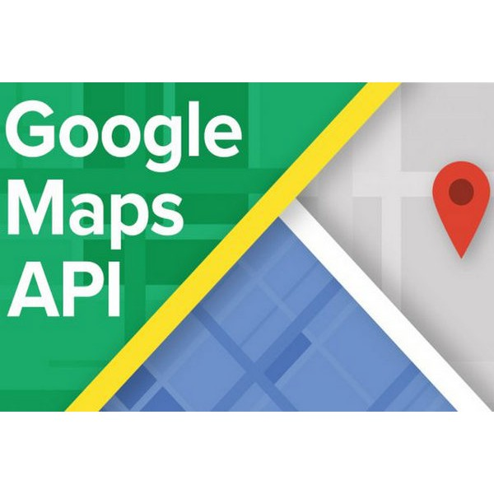
Web Scraping
Geocoding API
reverse_geocode
What does it do?
Retrieves information of a location according to the coordinates given.
Our objective:
Retrieve the postal code for each traffic camera’s coordinates

Slide 5
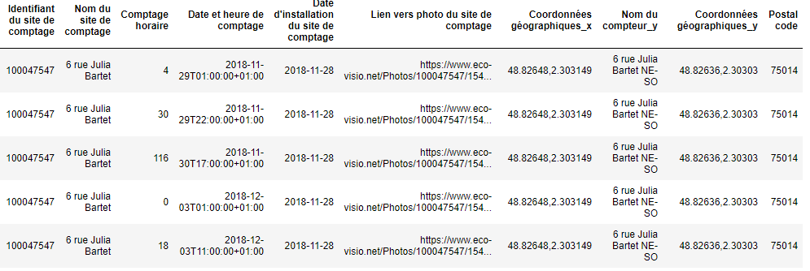
Web Scraping

Slide 6
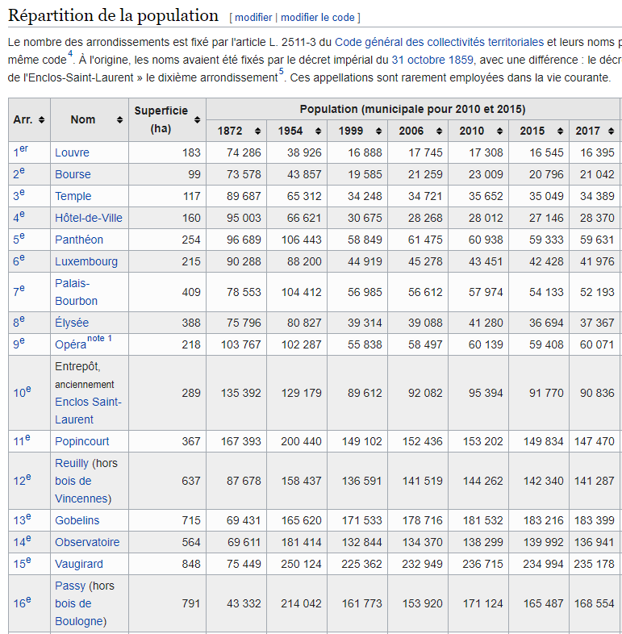
Web Scraping
Wikipedia page
Arrondissements in Paris
Objective:
Retrieve information about the surface of each arrondissement to correlate the number of accidents with the surface of the arrondissement.

Slide 7
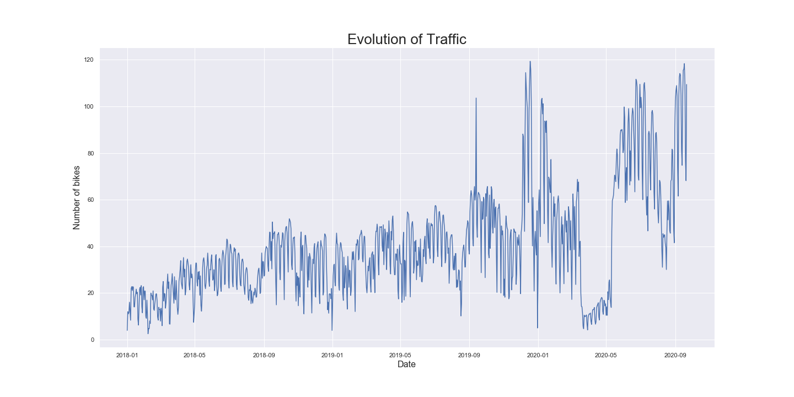
Results – Is there an increase in traffic?
December Strike
August Holidays
1st January
COVID Confinement

Slide 8
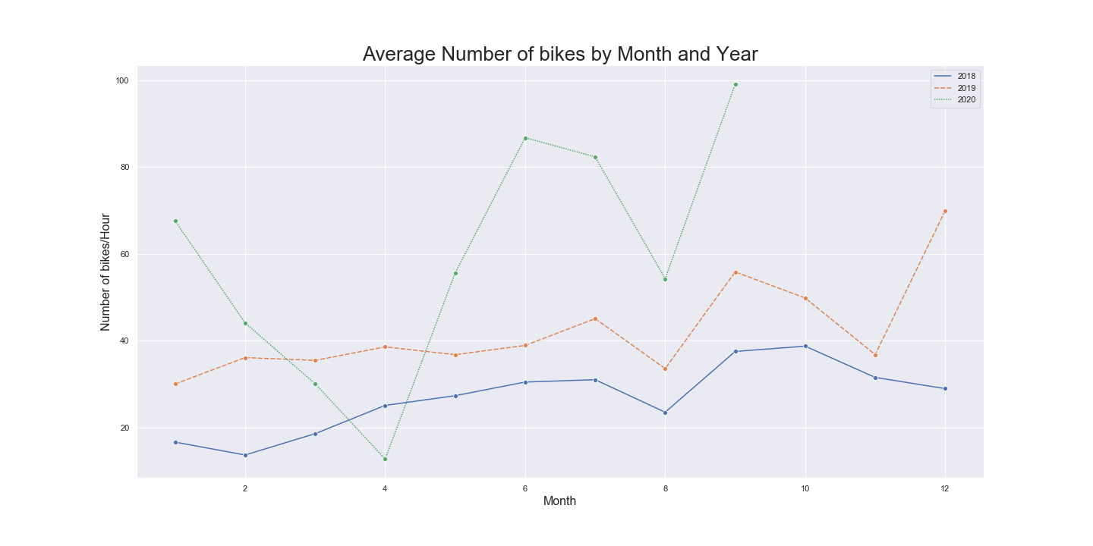
Results - Seasonality

Slide 9
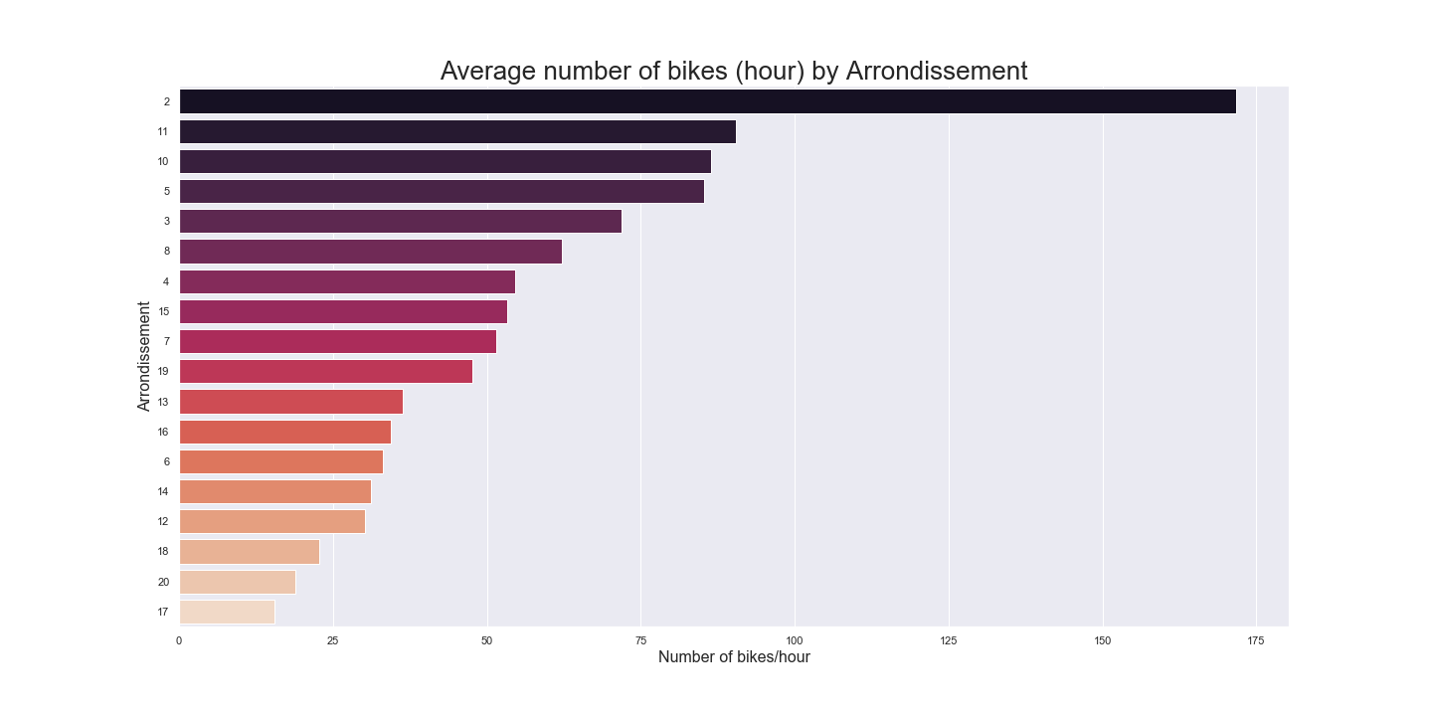
Results – Arrondissements with highest traffic

Slide 10

Results – Mapping the Arrondissements

Slide 11
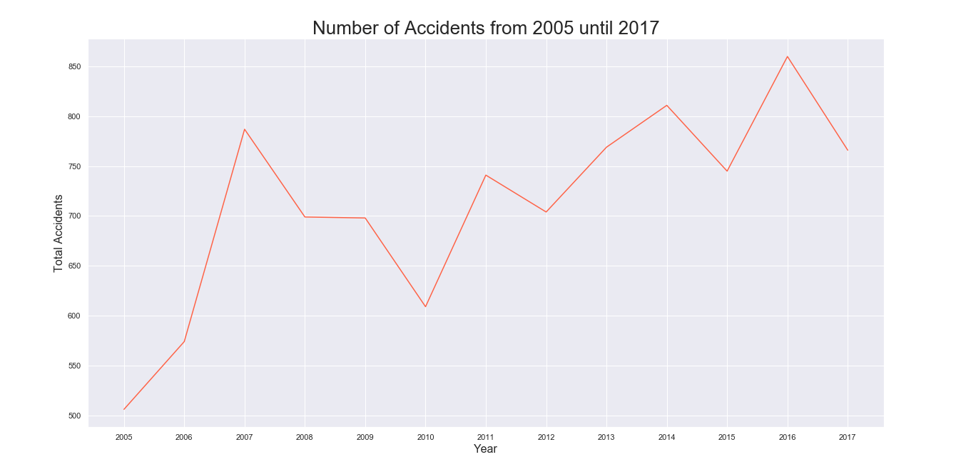
What about the Accidents?
Steady increase in the number of accidents between 2005 and 2017

Slide 12
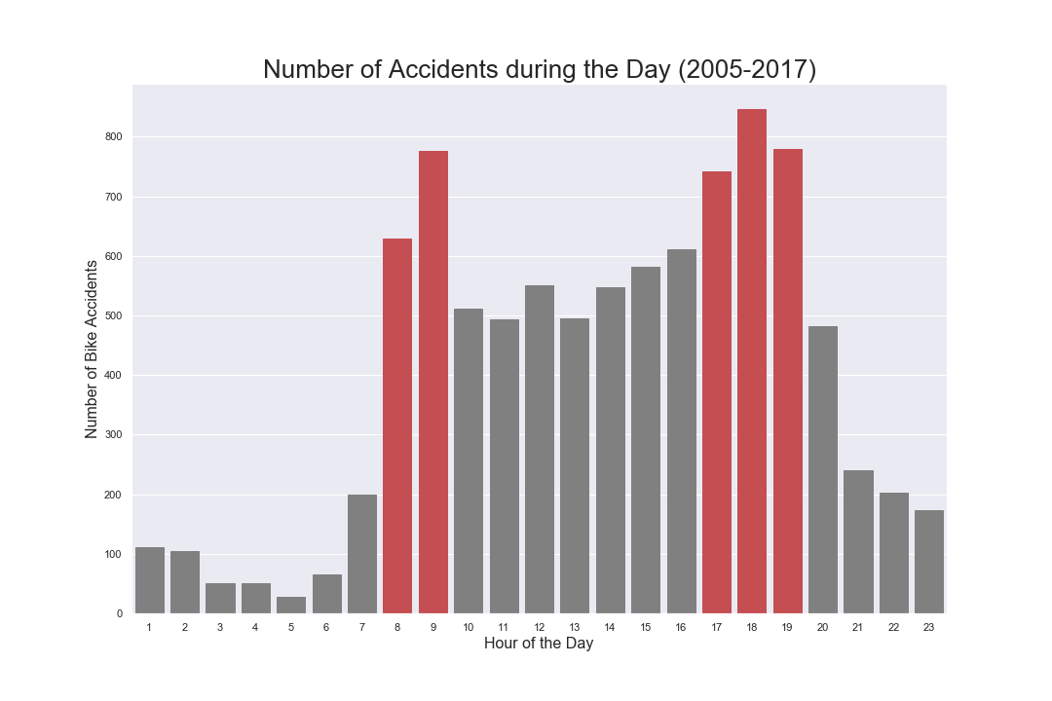
In what time of day there are more accidents?

Slide 13
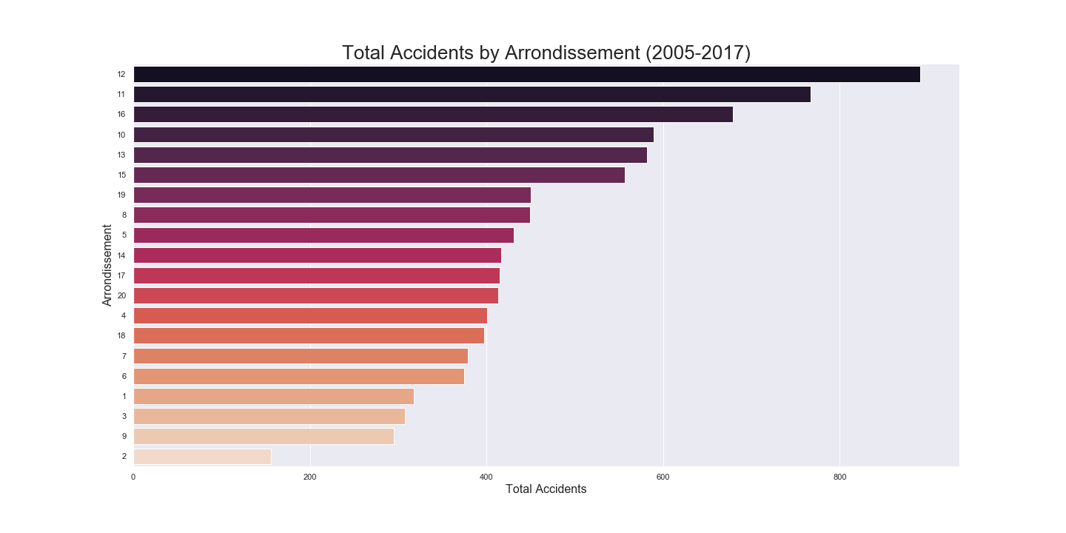
What are the Arrondissements with highest number of accidents?

Slide 14
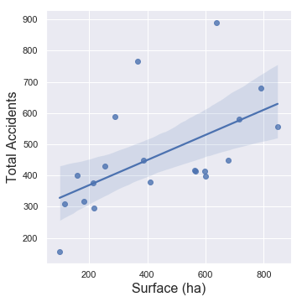
Is there a correlation between the number of accidents and the surface of the Arrondissement?

Slide 15
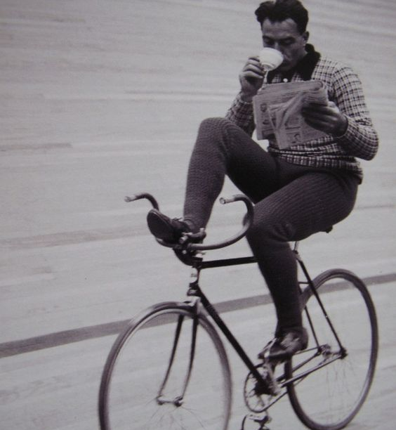
What have we learned?
We finally learned how to work with Github!
Using the Google Maps API
How to manipulate and clean data efficiently
Choose the visualizations that best describe the data in question
What are the arrondissements to avoid having a bike accident

Slide 16
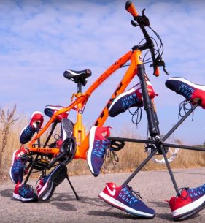
What we would have done differently?
Choose a dataset with more variables/columns
Do Hypothesis testing
Do more Web Scraping in order to get more variables
Do more planning in the beginning and think about the final data that we needed to have.

